Slide 1

KARPAGAM INSTITUTE OF TECHNOLOGY, COIMBATORE. (Approved by AICTE and Affiliated to Anna University) Accredited by NBA(CSE,IT,ECE) | Accredited by NAAC with ‘A++’grade DEPARTMENT OF INFORMATION TECHNOLOGY
SECOND REVIEW
WEBSITE FOR HERITAGE AND CULTURAL
GUIDE NAME
Ms.T.Yawanikha
Assistant Professor / IT in
Karpagam Institute of Technology
PRESENTED BY
Bhavya S (721220205302)
Janisha M (721220205015)
Kavearhasi V(721220205024)
Sowmiya D (721220205051)

Slide 2
ABSTRACT
The project focuses to develop a digital platform that create a comprehensive repository,ensure authenticity and fosters cross generational dialogue for the appreciation and revitalization of diverse cultural element to preserve endangered indigenous heritage and cultural amidst modern challenges.
A core focus is on preserving endangered indigenous heritage that is under threat.The digital platform serves as a means to safeguard these valuable cultural assets.

Slide 3
PROPOSED SYSTEM
We aimed to create a platform that not only educate people about the heritage but also provide opportunities to grow their business,share their thoughts and knowledge to world wide
The platform will provide a space for indigenous individuals and businesses to receive support and collaboration from others. This can include networking opportunities, partnerships, and access to resources that can help them to succeed in their endeavors.

Slide 4
MODULES
Register
Login
Home
Edit Profile
Admin Pannel
My Shops
Shop Crud
Item Crud

Slide 5
MODULE DESCRIPTION
Register
This module involves the initial step of registration of people.
Login
The login page servers as the entry point for users to access their accounts on our platform.It provides a secure interface for both existing and new users to authenticate themselves and gain access to the platform features and functionalities.
Home
This module shows many features were provided by the website. The free open source platform built with indigenous communities to manage and share digital culture heritage.

Slide 6
Edit Profile In this module allows users to modify their personal information , contact details , profile picture biography , and links within a system or platform .
Admin Pannel
The admin panel module serves as a central tool for managing various aspects of an application
or system allowing administrations to control user activities and access.
My Shops
My shop module is a features in various platform that allows users to view their own shops or
stores.
Shop Crud
The shop crud module combines the functionalities of managing shops or stores with the
essential crud operations – create , read , update and delete .
Item Crud
In this module is a tool that enables users to manage the creation , modification , and deletion .

Slide 7
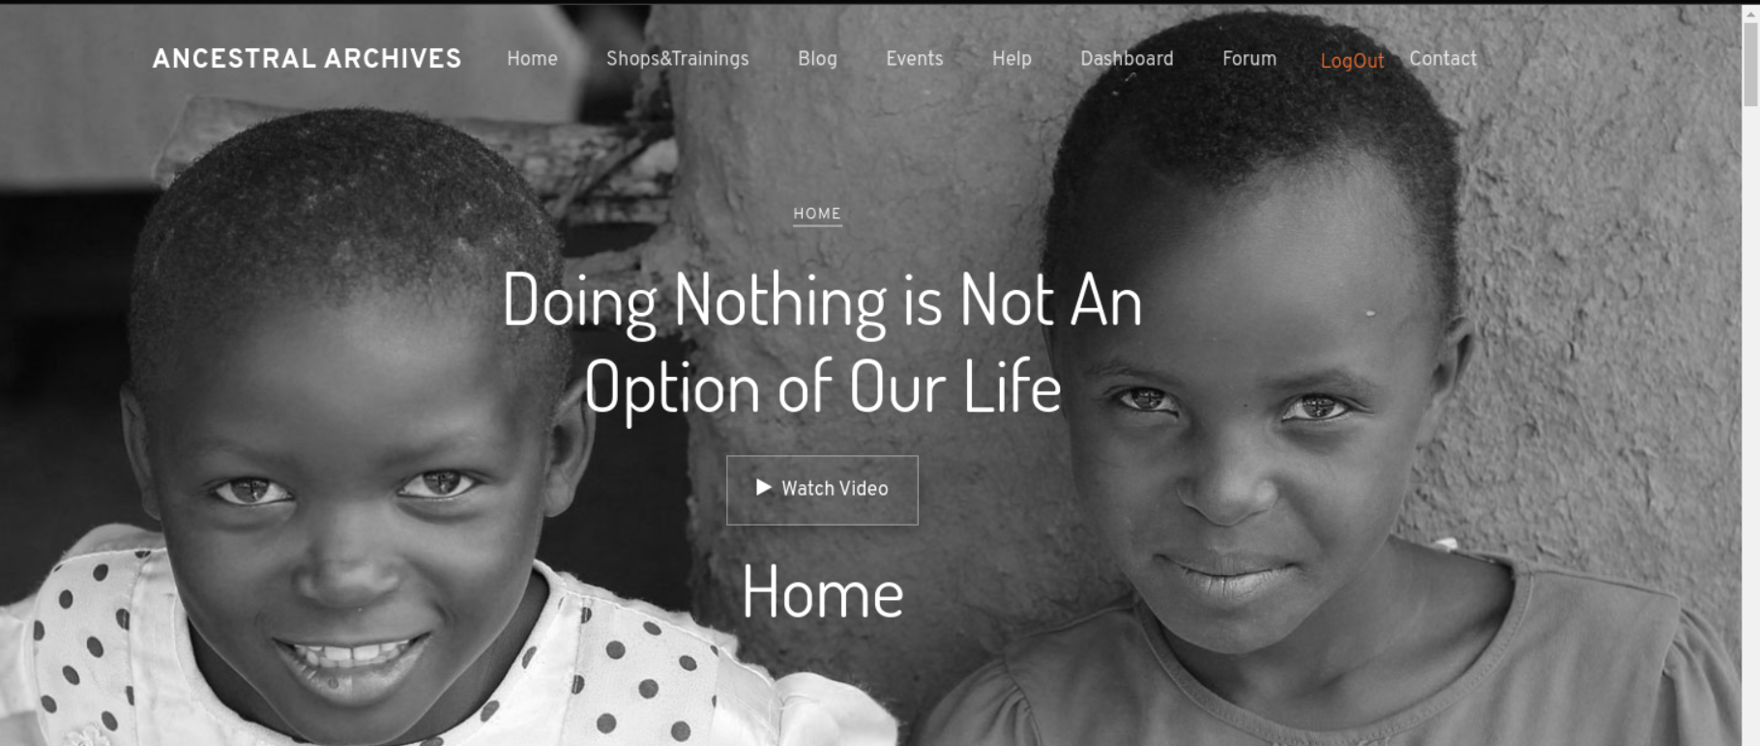
MODULE IMPLEMENTATION
Home

Slide 8
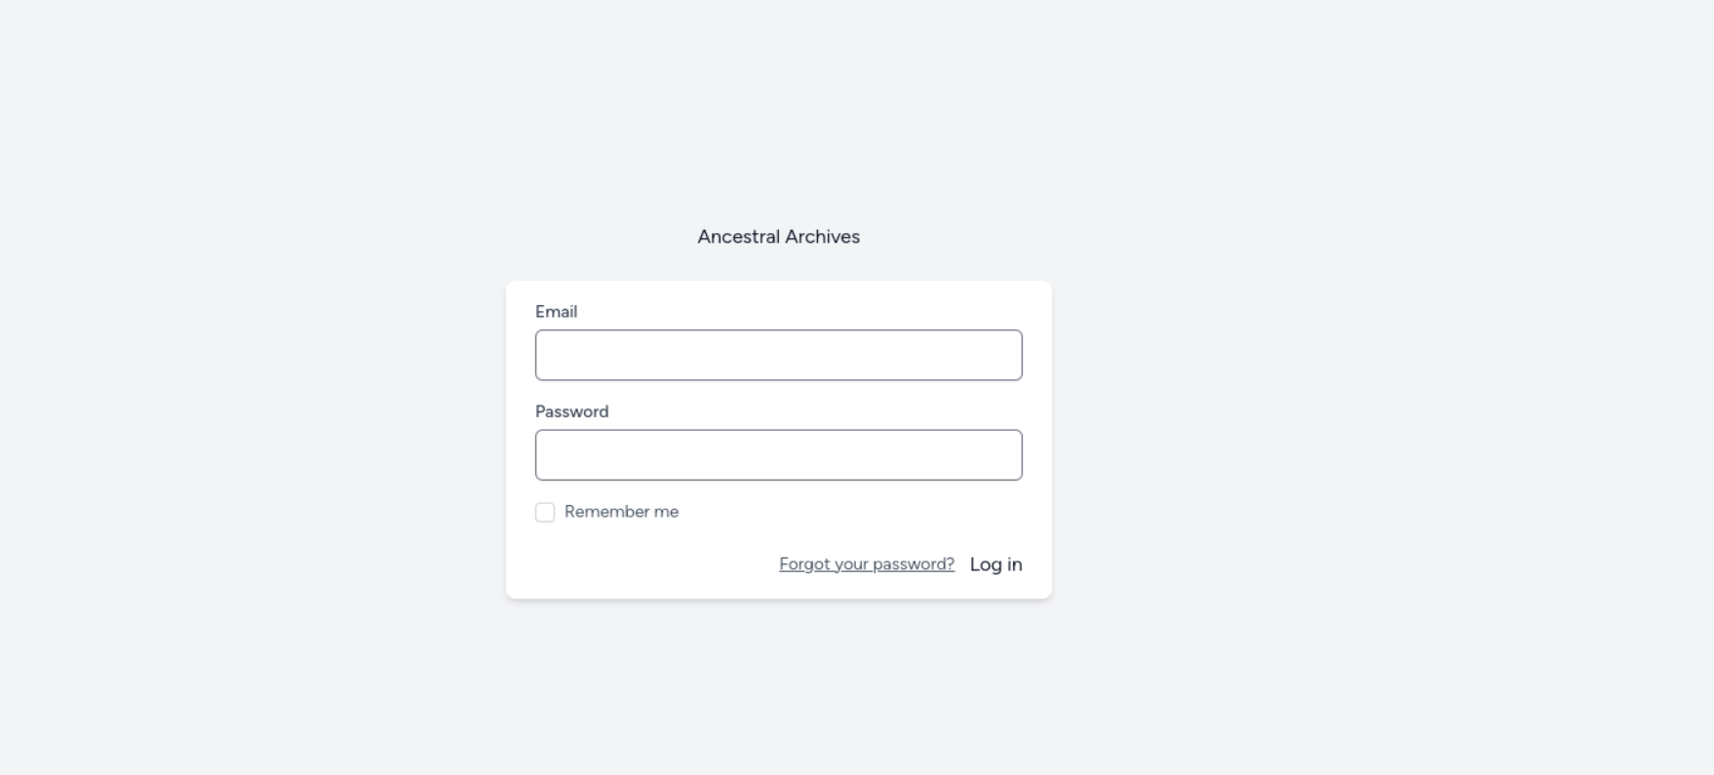
MODULE IMPLEMENTATION
Login

Slide 9
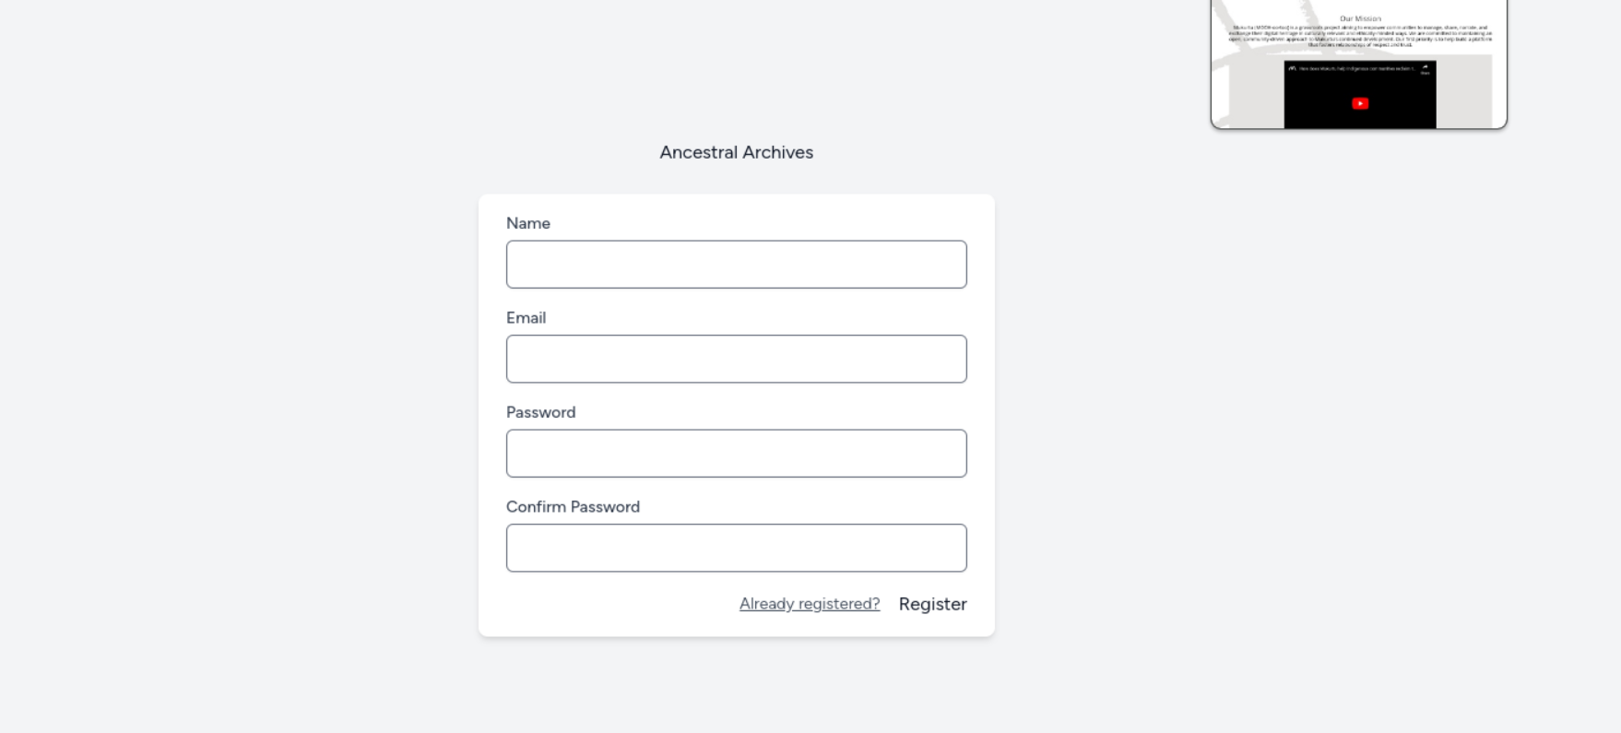
MODULE IMPLEMENTATION
Register

Slide 10
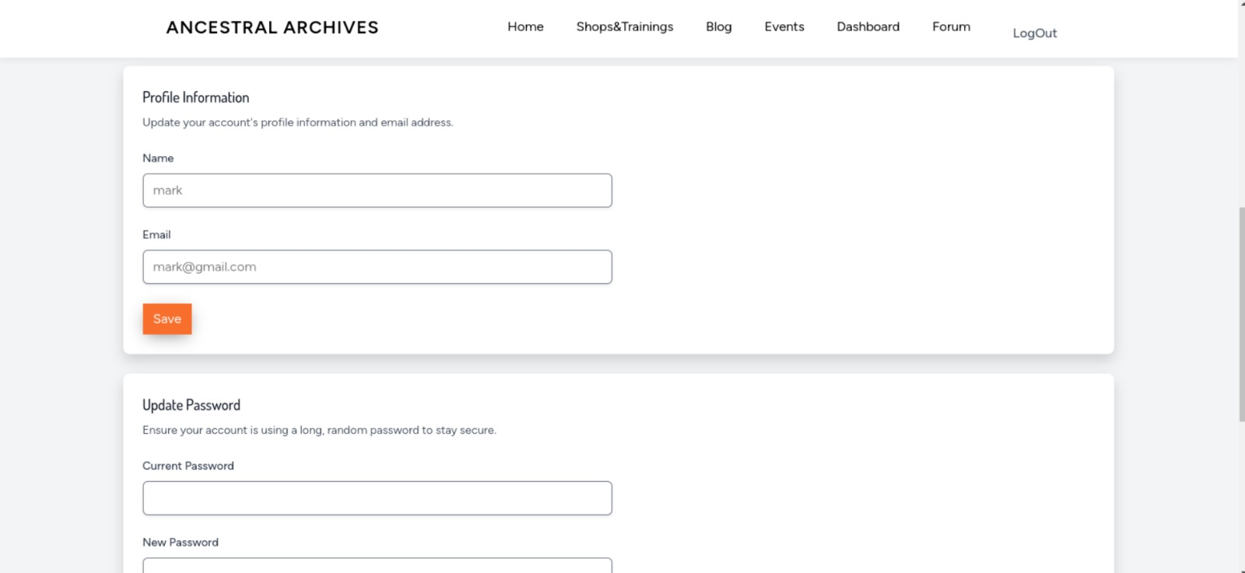
MODULE IMPLEMENTATION
Edit Profile

Slide 11
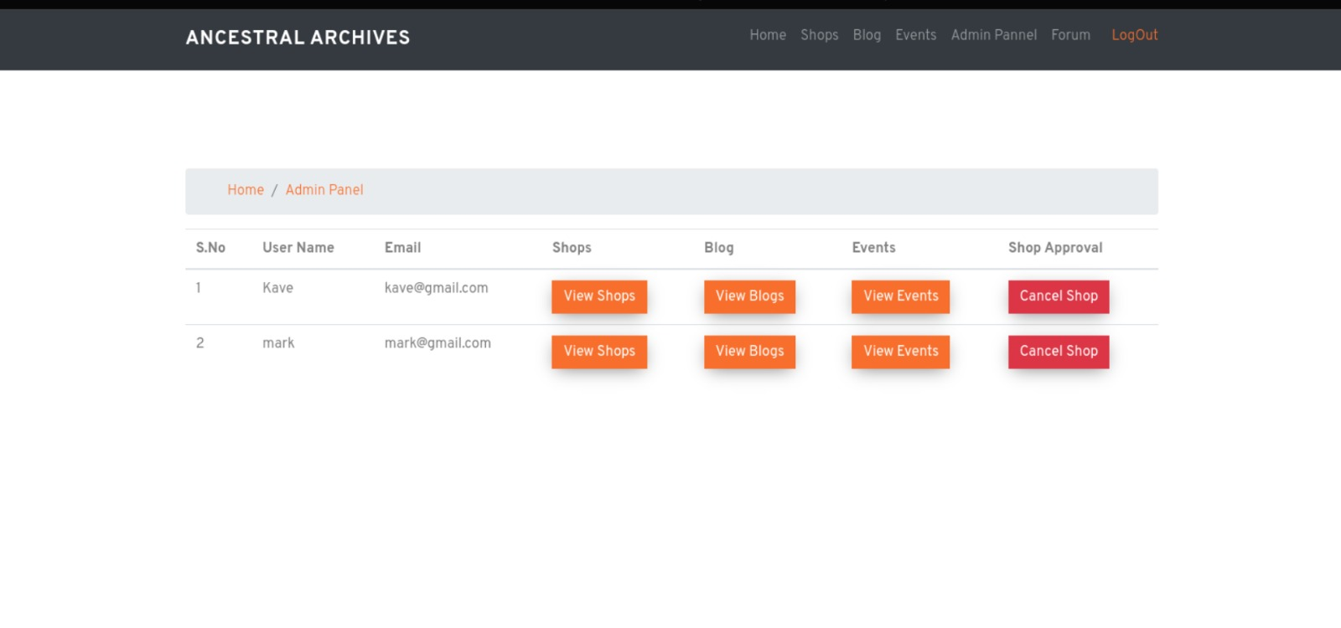
MODULE IMPLEMENTATION
Admin Pannel

Slide 12
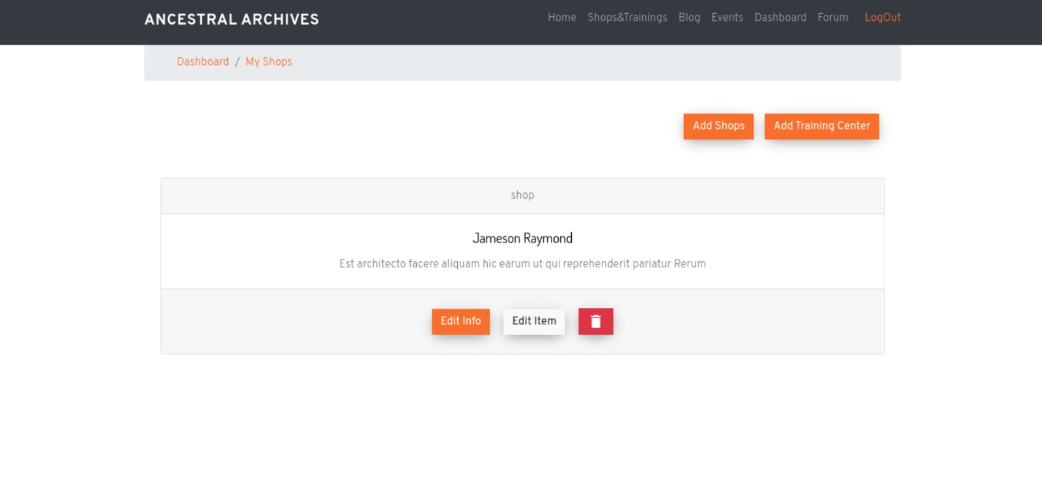
MODULE IMPLEMENTATION
My Shops

Slide 13
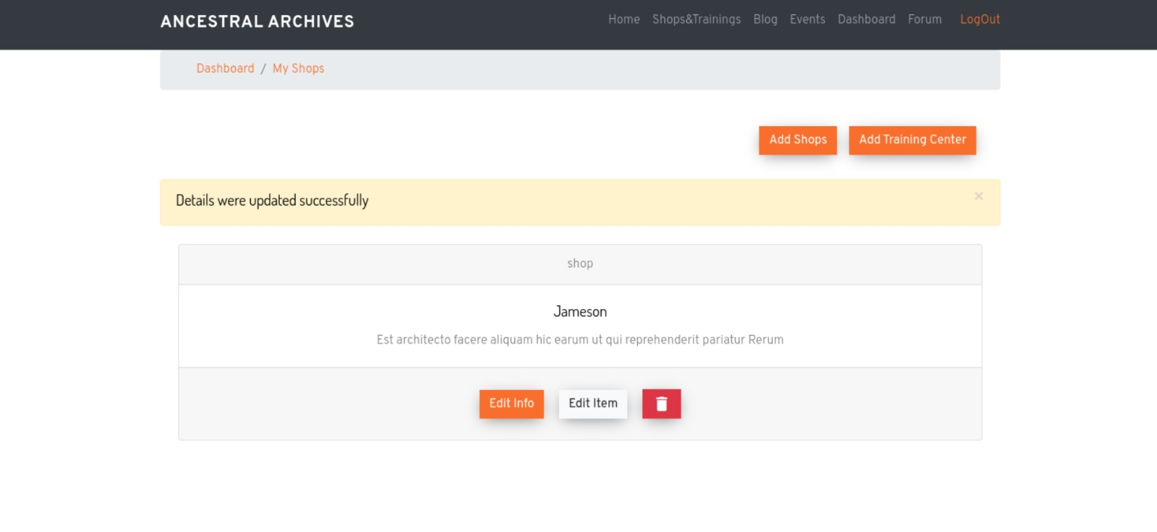
MODULE IMPLEMENTATION
Shop Crud

Slide 14
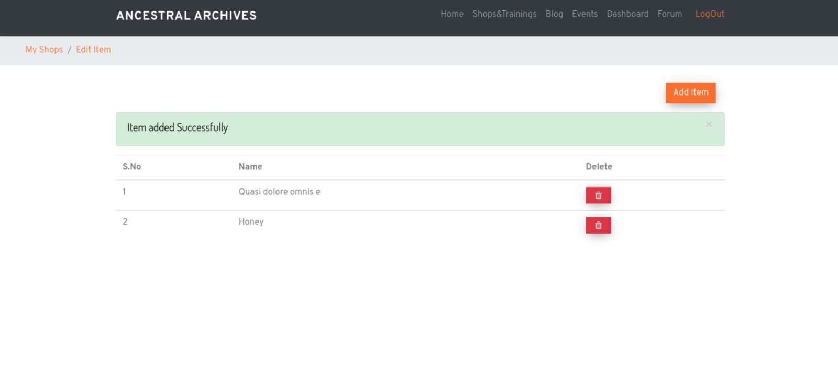
MODULE IMPLEMENTATION
Item Crud

Slide 15
REFERENCES
https://mukurtu.org/about/

